Slide 1

Unlock Collateral for Yield
Mindao YANG
Founder at dForce

Slide 2
DeFi Protocols Underutilize its Collaterals

Slide 3
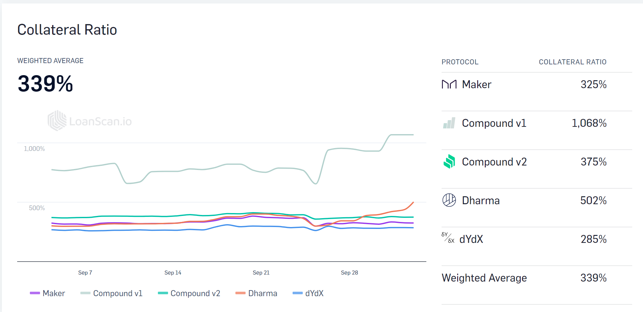
DeFi Over-collateralization
Source: loanscan.io as of Oct 3 2019

Slide 4
The Great Yield War in Defi and CeFi

Slide 5
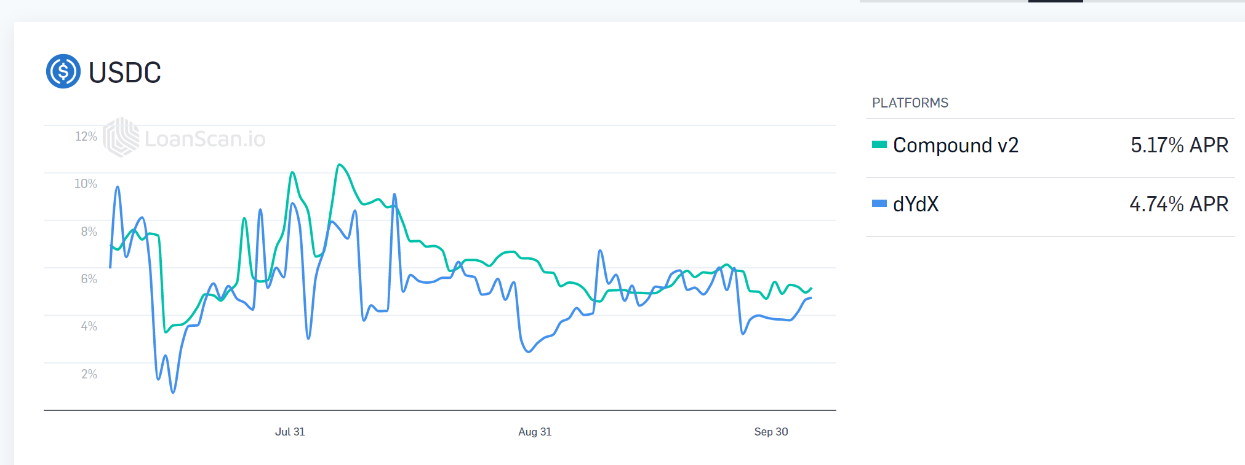
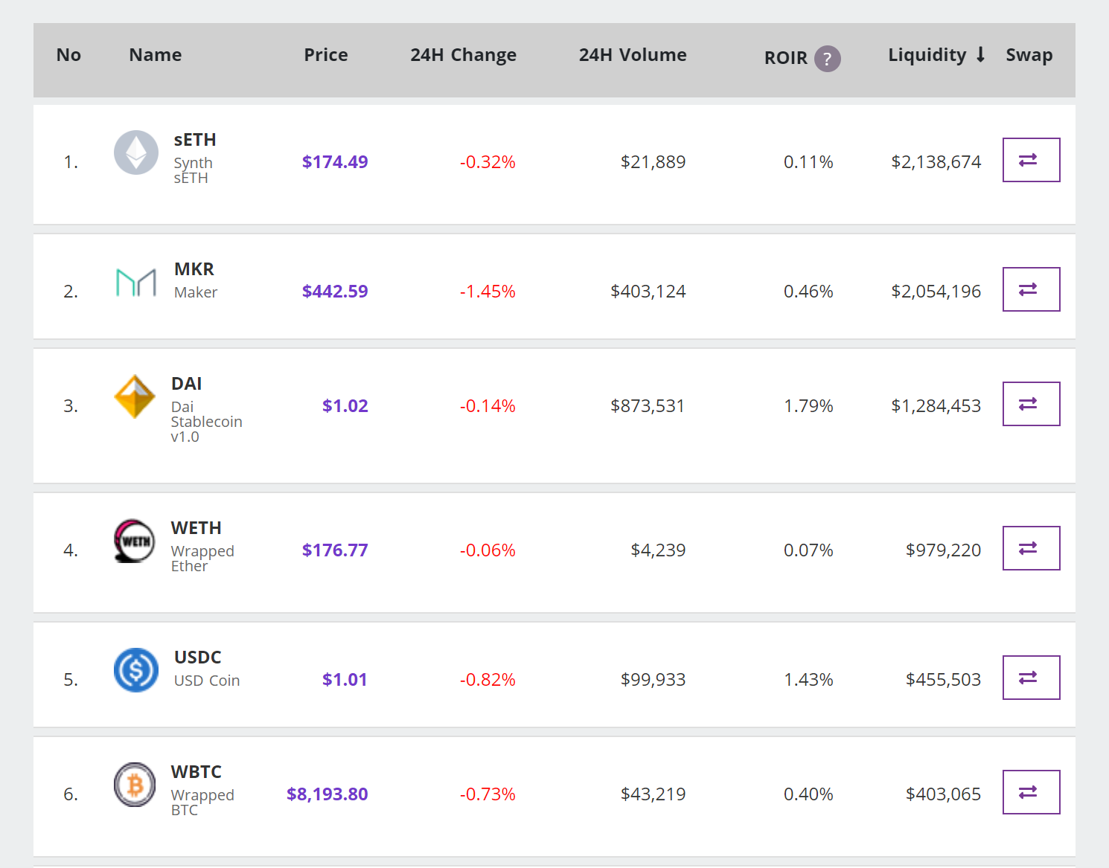
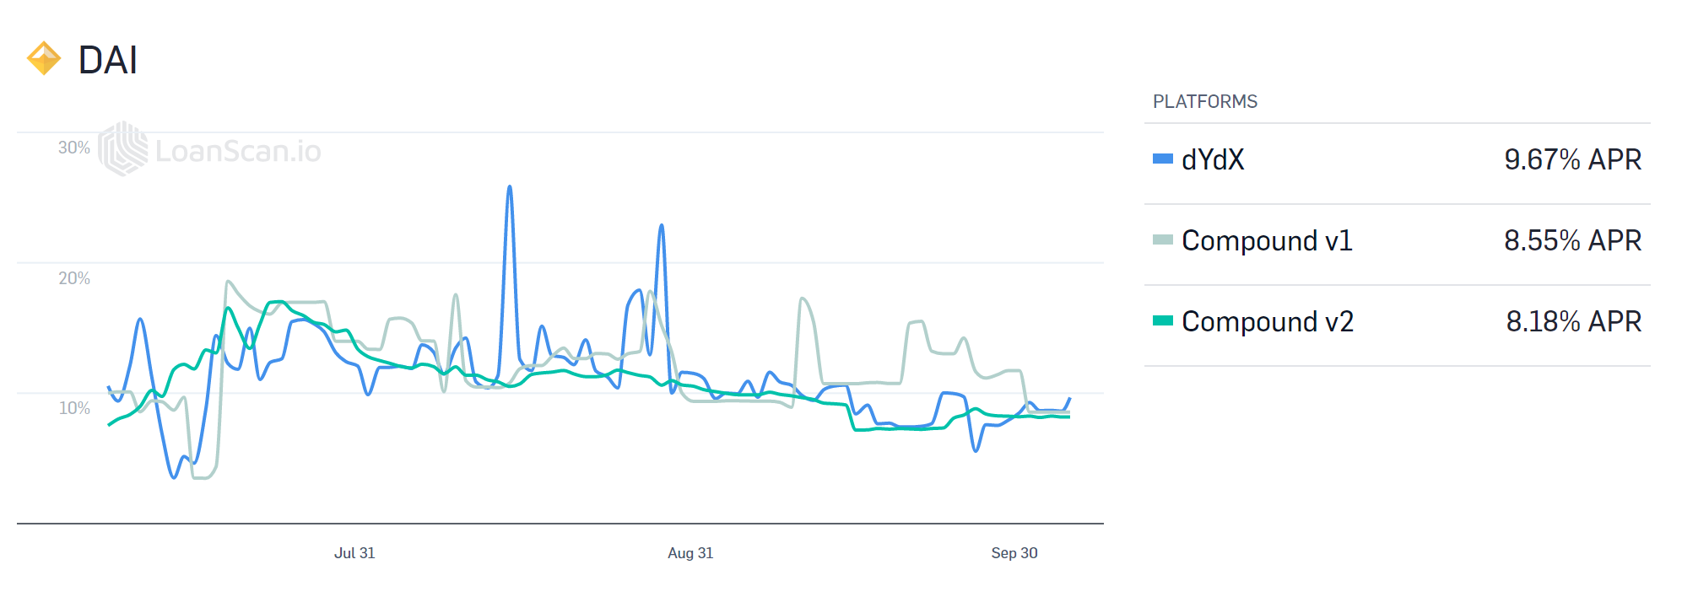
The Yield War in Defi
Source: loanscan.io and uniswapdex as of Oct 3 2019

Slide 6
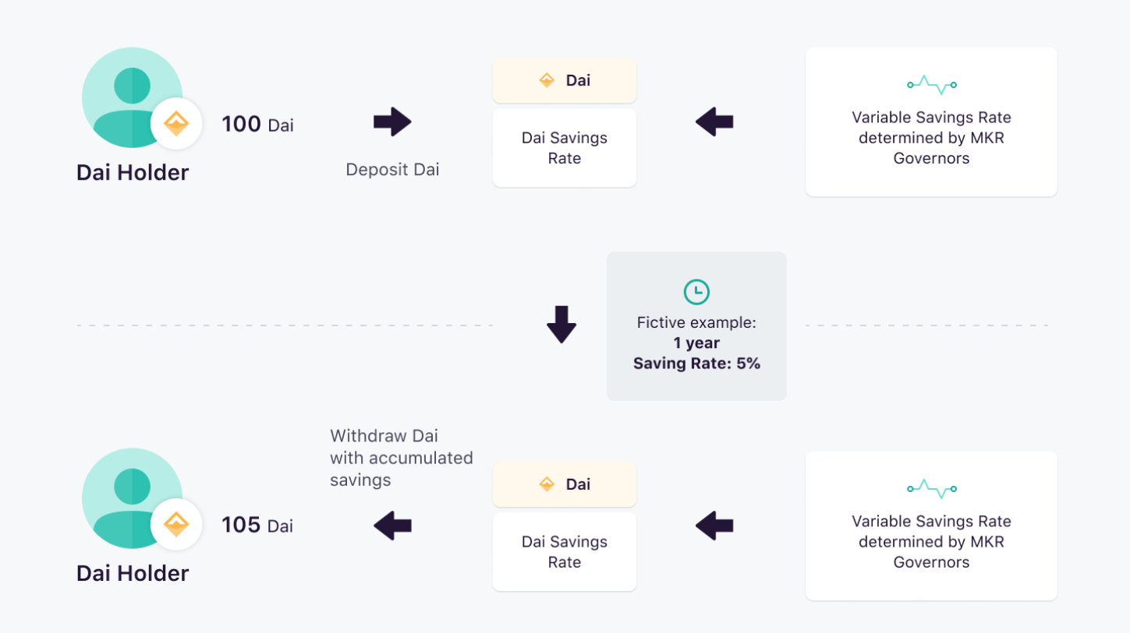
DAI is Launching DSR with MCD
DAI Holders to lock DAI in DSR contract – liquidity locked-up
DAI system pay interest on locked DAI
Available to anyone accessing DSR Contract

Slide 7
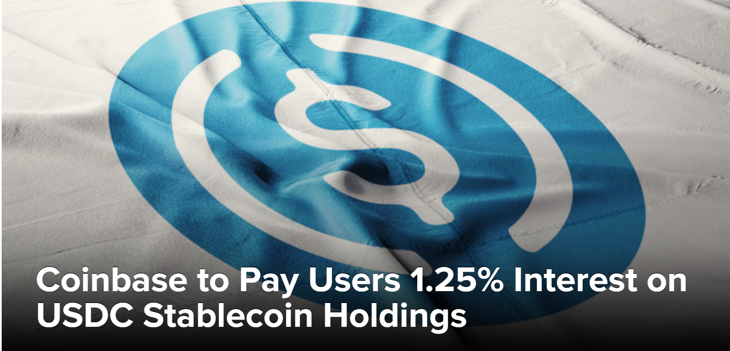
Coinbase is Providing USDC yields
USDC held with Coinbase
USDC are paid with interest
Non-viable outside of Coinbase

Slide 8
Framework to liquify collateral

Slide 9
General Framework:
Protocol Test:
Collateralized and over collateralized protocols（Maker, Uniswap, USDx）
Protocols with liquidity buffer (i.e don’t require 100% liquidity)
Collateral with interoperability and yield generating capability
Key Risk Parameters:
Liquidity parameters:
minimum liquidity requirements (i.e 35%)
liquidity share in yield protocols, i.e less than 15%
Yield protocol management
protocol selection (code audit, open source etc)
automatic switches
tokenized yield (i.e cToken)
smart contract insurance
Backstop mechanism:
risk ringfencing
decoupling risks associated with compossibility/interdependences

Slide 10
Implementation for USDx
assuming 35% of collateral unlocked and supplied to yield protocols (5% APR)
Interest earned pooled and supply systematic APR 1.8% for all USDx holders
USDx holders are able to claim systematic interest without liquidity lock-up

Slide 11
Implementation for DAI
ETH/DAI collateral ratio stands at 331%
assuming 35% of ETH collateral unlocked and supplied to yield protocols
DAI holders are able to claim ETH yield from the pool

Slide 12
Implementation for StableSwap
StableSwap is being developed by dForce community (replacing ETH with a stablecoin (USDx）as reserve)
Interest earned from relending reserve assets (USDx）is able to compensate market makers.

Slide 13
Yield Enhancement Sensitivities
Assuming an unlocked ratio of 35% and yield protocol with 5% APR.
the collateral is able to generate 1.8% systematic APR for the stable asset.
The more unlocked the higher the systematic APR for the target asset.
How far can we go to optimize unlocked ratio

Slide 14
Blended Collateral Ratio Sensitivities
Assuming 35% unlocked collateral and 150% minimum collateral ratio of lending protocols, overall collateral ratio improve from 100% to 118%
Liquifying is not de-collateralizing

Slide 15
Next to Watch
USDx with systematic yield from unlocked collaterals
Reserved-based dex with interest from reserve
CNYx with DIP 001
https://github.com/dforce-network/DIP001

Slide 16

Reimagine Money Reinvent Finance
Image credit: M. Ghezel
Telegram: t.me/dforcenet

